Slide 1
Deconstructing IoT- Role of Middleware and Protocols
Abhishek
Notes:
Module 1 and 2

Slide 2
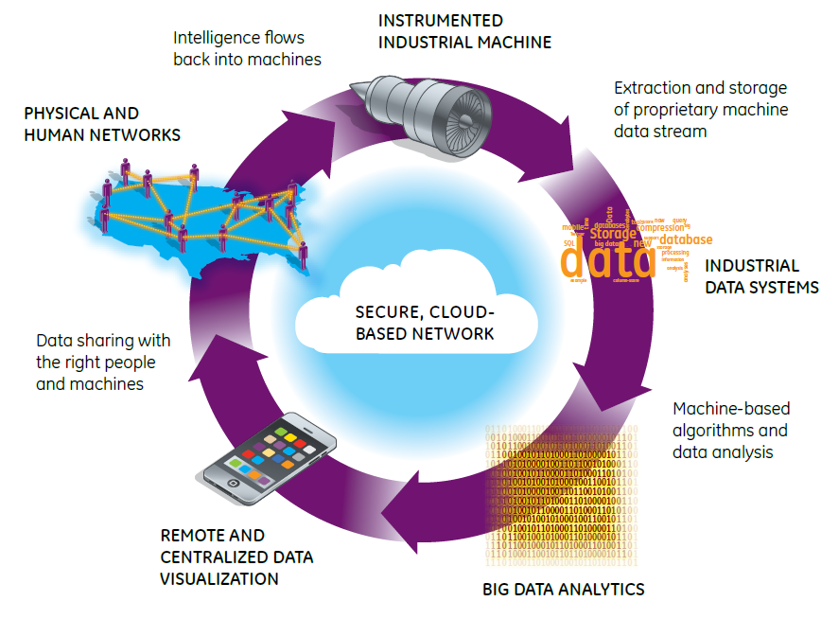

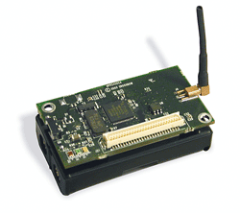

Deconstructing Smart IoT Systems
Human Layer
Environment
Sensors
Human Networks
Data Streams
Smart Application Layer
Decision Support Systems
Data Sharing
Platform
Networking Layer
Physical System and Sensors
UI and Information Presentation
Decision Support Systems: Big Data Analytics

Slide 3
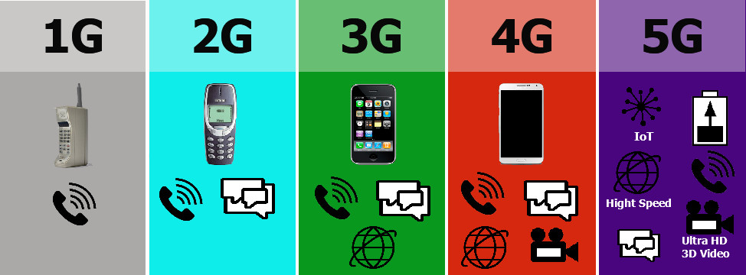

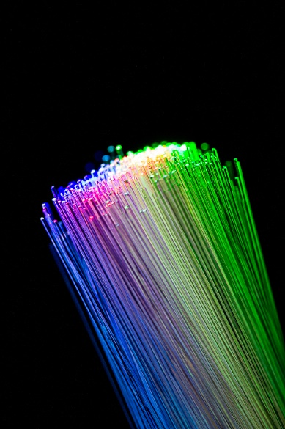
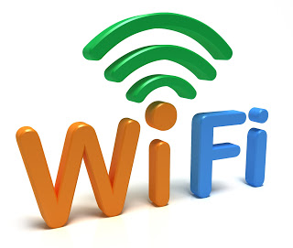
Networking Layer
Human Layer
Smart Application Layer
Decision Support Systems
Networking Layer
Physical System and Sensors
The data from the IoT Sensors have to be moved in real-time to a computation backend for analysis.
Must deal with a range of networking technologies
The tradeoff is between throughput, cost, and timeliness and reliability of data transfer
Notes:
Explain the concept of protocol.

Slide 4
IoT Low Energy Physical layer

Slide 5
IoT Middleware
IoT environments are often resource-constrained and hence involve low bandwidth communication
Safe and reliable communications are desired for IoT
Existing protocols can be divided into network-level and data-level protocols
Several different protocols exist, and more are researched on
Source: 15 protocols listed at https://www.ubuntupit.com/top-15-standard-iot-protocols-that-you-must-know-about/

Slide 6
IoT Protocols – Bluetooth Low Energy
Provides significantly reduced power consumption and cost while still maintaining the range of traditional Bluetooth (100 meters/300 ft)
Uses the same 2.4 GHz spectrum as the classic Bluetooth but uses different channels
0.27 to 1.37 Mbits/sec throughput
0.01 to 0.5 Watts power consumption
128 bit AES security
Goal is to support months to years of operational capabilities on a single button cell
A special interest group (SIG) maintains the BLE specification
Applications built using the Generic Attribute Profile (GATT), which specifies short pieces of data can be sent/received over low energy link
Additional domain-specific profiles are available per industry vertical, e.g., healthcare, fitness
BLP (blood pressure profile), HRP (heart rate profile), WSP (weight scale profile)

Slide 7
IoT Protocols - Wifi
IoT applications may involve anywhere from short messages to continuous data streams, and short range communication (e.g., wearables) to communication over several kilometers (e.g., weather, agriculture); power constraints still exist irrespecive
WiFi provides low cost and ubiquitous deployment
Traditional WiFi (i.e., 802.11 a/b/g/n/ac) have high power consumption, smaller range, and is vulnerable to spectrum congestion
2 emerging IEEE standards: WiFi HaLow:802.11ah and WiFi HEW: 802.11 ax and ay
HaLow uses 900 MHz ISM band to provide extended range (almost double that of traditional WiFi) at low power consumption;
Goal is to support applications like smart homes, connected cars, smart city, etc
however it needs specialized access points and chip vendors are slow in bringing the technology to market
High Efficiency Wireless (HEW) operates in all band spectrums from 1 to 7 GHz with top speeds of 11Gbits/sec
WiFi Alliance calls it WiFi 6
Meant to operate with high performance despite many connected devices
Improved power efficiency

Slide 8
IoT Protocols - ZigBee
Based on the IEEE 802.15.4 specification for personal area networks
Low cost, low power wireless mesh network standard
Operates in the ISM band, usually at 2.4 GHz with data rates up to 250 kilobits/sec
Intended to be simpler and less expensive that Bluetooth
10 to 100 meters line-of-sight communication range
Battery life must be at least 2 years to be certified as ZigBee
Not suitable for nodes with high mobility
Application areas are numerous
Home automation, industrial control, medical data collection, smoke/fire alarms, remote microphone control, building automation, etc.
Application profiles per application area
(www.zigbee.org)

Slide 9
IoT Protocols – LoRaWAN
Long Range Wide Area Networks (LoRaWAN) is a low power wide area wireless networking meant to connect IoT devices over networks of multiple different scales providing bi-directional communications
Typically deployed in “star of stars” topology where gateways relay messages between end devices and a centralized server
Gateways convert radio frequency packets into IP packets and vice versa
LoRa is the long range physical layer that enable single hop link between end devices and gateways
Proprietary physical layer, however, an alliance exists
LoRaWAN provides media access and network layer protocols above LoRa
Communication range over 10 kms, however, at smaller data rates (50 kbps)
Not useful for building real-time applications
https://lora-alliance.org/about-lorawan

Slide 10
IoT Protocols – LPWAN/SNOW
Low Power Wide Area Network (LPWAN)
Sensor Networks over Whitespaces (SNOW)
LPWAN offers low power, long range, low cost connectivity for IoT devices which can be realized in various kinds of physical layers
SNOW is a LPWAN technology borne out of academic research that exploits the unused spectrum of TV channels – the so called whitespaces – for long range, low power communication
ISM bands are often crowded while whitespaces are not, and in fact offer a wider spectrum
Practical deployment described in http://www.cs.wayne.edu/saifullah/iotdi19.pdf

Slide 11
IoT Protocols – Z-Wave
Wireless communication protocol meant primarily for home automation
Mesh network with low energy radio waves and no coordinator node
There is a Z-Wave alliance (https://z-wavealliance.org/)
Over 100 million products sold
Found in hotels, cruise ships, alarm companies, etc
No interference from WiFi, Bluetooth, etc
Meant to send short sized messages on half-duplex channels
Range: 30 meters indoors; 100 meters outdoors
Maximum nodes: 232 in a mesh
https://www.z-wave.com/

Slide 12
IoT Protocols – SigFox
Rolling out a global IoT network
Software-based communication where all the complexity is managed in the Cloud rather than the devices
Uses ultra narrow band (200 KHz of publicly available band)
Lightweight protocol, small message sizes
Star network
https://www.sigfox.com/en/sigfox-iot-technology-overview

Slide 13
IoT Protocols – NFC (Near Field Communications)
For contactless communication between devices like smartphones
One can just wave one device over another device that is also NFC-enabled and information can be transmitted between them without the need for connection setup
Essentially, a radio frequency current is established between the two communicating devices
NFC is a subset of RFID and uses 13.56MHz frequency
A typical communication involves a “reader” or “interrogator” node communicating with a “passive” node
Useful in boarding subway trains, paying bills in grocery stores, etc all from a single device
Used in Apple Pay, Android Pay, Samsung Pay
NFC-based payments are dynamically encrypted making them secure
EMV (Europay, Mastercard and Visa) is different from NFC and is the credit card chip technology
http://nearfieldcommunication.org

Slide 14
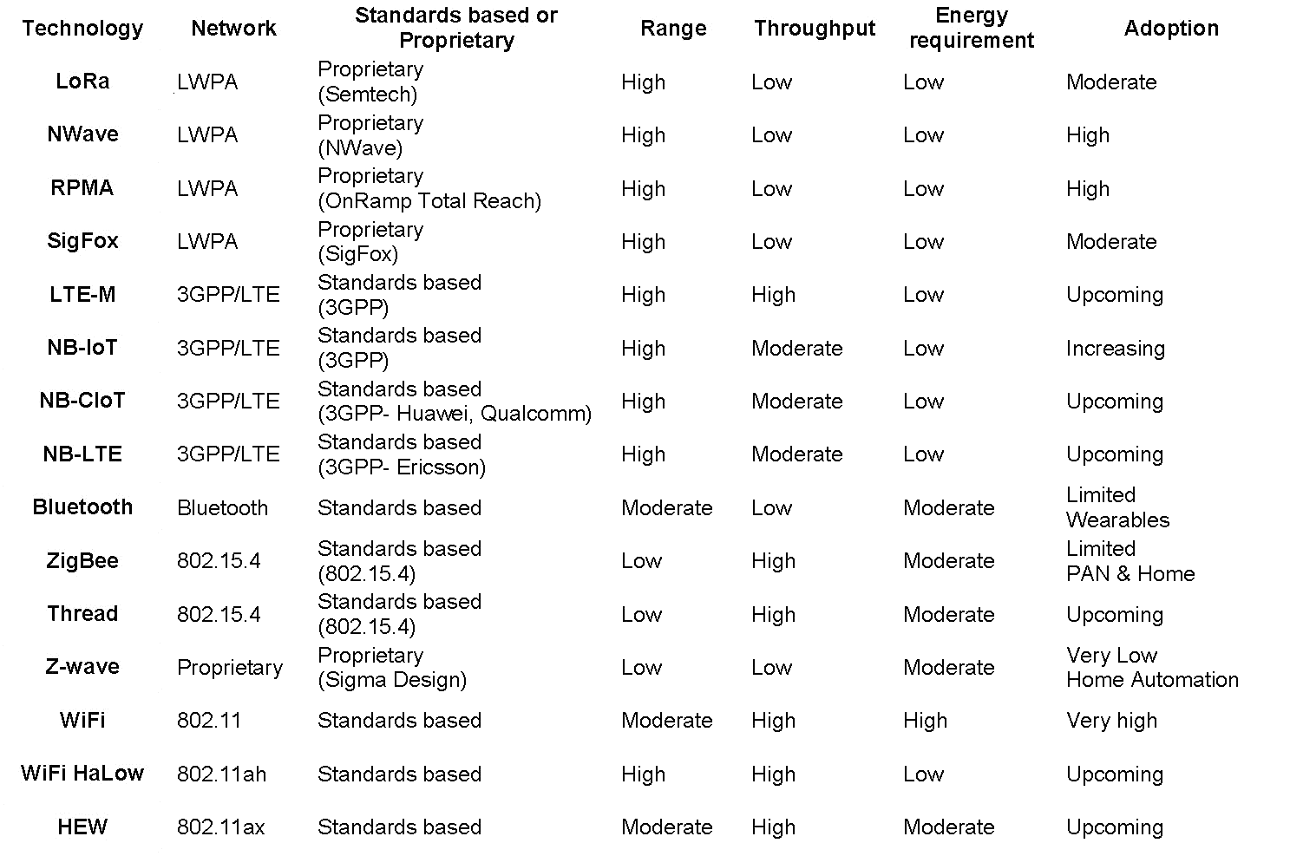
IoT Protocols – Comparison
Source: https://www.networkworld.com/article/3196191/wifi-s-evolving-role-in-iot.html
Notes:
Ask Marc to say that right now LoRA

Slide 15
IoT Middleware

Slide 16
What is middleware
Distributed applications written with socket can become cumbersome.
There are a few problems that must always be solved.
Hardwiring target addresses – a client needs to know the server IP
Typical protocol is A sends data to B, then B replies while A waits and then then A responds back.
Data marshalling problem. How do you decide what is the on-the wire protocol.
Can we abstract away the gory details of the communication from the computation aspect of the distributed application?

Slide 17
What is middleware
Think of middleware as a combination of services [external processes] and libraries that solves the problems of slide 2.
Services provided can be
Discovery – automatic wiring of clients and servers
Improved fault tolerance and restart of dead processes.
End to End Quality of service Management, etc.
The library can provide
Core communication design patterns [we will talk about it]
Automatic encoding and decoding of messages
Provide callback for invoking a function when data is received.
Advanced buffering capabilities to allow handover of certain tasks to the middleware
For example, connection set is managed by several threads running in background in zero MQ

Slide 18
Communication Patterns
Communication patterns can be generally divided into two groups
Asynchronous Interaction – The parties do not wait for a response and computation can start without waiting for communication to finish.
Synchronous Interaction - Computation is blocked to ensure that the communication finishes.
Asynchronous Interaction
Publish/Subscribe
Async request reply
Synchronous Interaction
Request Reply

Slide 19
What is a Publish/Subscribe System?
(Distributed) Pub/Sub System is a communication paradigm that allows freedom in the distributed system by the decoupling of communication entities in terms of time, space and synchronization.
An event service system that is asynchronous, anonymous and loosely-coupled.
Ability to quickly adapt in a dynamic environment.

Slide 20
Key components of Pub/Sub System
Publishers : Publishers generate event data and publishes them.
Subscribers : Subscribers submit their subscriptions and process the events received
P/S service: It’s the mediator/broker that filters and routes events from publishers to interested subscribers.

Slide 21
Classification of Pub/Sub Architectures
Peer-to-Peer model
Each node can be publisher, subscriber or broker.
Subscribers subscribe to publishers directly and publishers notify subscribers directly. Therefore they must maintain knowledge of each other.
Complex in nature, mechanisms such as DHT and CHORD are employed to locate nodes in the network.
E.g. distributed event service

Slide 22
Key functions implemented by P/S middleware service
Event filtering (event selection)
The process which selects the set of subscribers that have shown interest in a given event. Subscriptions are stored in memory and searched when a publisher publishes a new event.
Event routing (event delivery)
The process of routing the published events from the publisher to all interested subscribers

Slide 23
Event Filtering (Subscription Model) Topic based VS Content based
Topic based
Generally also known as topic based, group based or channel based event filtering.
Each event is published to one of these channels by its publisher.
Subscribers subscribes to a particular channel and will receive ALL events published to the subscribed channel.

Slide 24
Topic-based subscription
Simple process for matching an event to subscriptions. However, limited expressiveness.
Event filtering is easy, event routing is difficult (Heavy load on the network). The challenge is to multicast event effectively to subscribers.

Slide 25
Event Filtering- Subscription Model Topic based VS Content based
Content based
More flexibility and power to subscribers, by allowing more expression in arbitrary/customized query over the contents of the event.
Event publication by a key/value attribute pair, and subscriptions specify filters using a explicit subscription language.
E.g. Notify me of all stock quotes of IBM from New York stock exchange if the price is greater than 150

Slide 26
Content-based Subscription
Added complexity in matching an event to subscriptions. (Implementation: Subscription arranged in a matching tree, where each node is a partial condition.
However, more precision is provided and event routing is easier

Slide 27
Event Routing
After filtering the events, the broker/brokers must route the events to the corresponding subscribers.
Can be done in the following ways:
Unicast
Multicast
Server push/ client pull

Slide 28
Event Routing
The broker makes the decision: how to route the message to the subscriber.
Several optimization schemes are available.
Profile forwarding scheme – brokers only forward the event to their neighbor broker which fulfill their subscription
Filtering the total covering of the subscription of the system – accept publisher events only if a subscriber has subscribed this event.

Slide 29
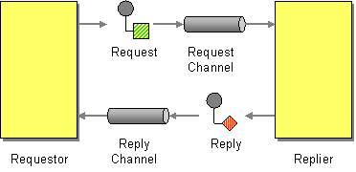
Request Reply Pattern

Slide 30
ZERO MQ Request reply example
https://learning-0mq-with-pyzmq.readthedocs.io/en/latest/pyzmq/patterns/client_server.html

Slide 31
Asynchronous Request Reply
The client does not wait for the server to respond. Rather it attaches a callback to be executed when the message arrives.

Slide 32
MQTT
MQTT (Message Queuing Telemetry Transport) is a simple and lightweight, publish/subscribe messaging protocol for machine to machine/IoT communications
Became an OASIS standard
Uses a broker for communication between publishes and subscribers
14 different message types supported
Quality of Service can be specified on the connection: “at most once”, “at least once” and “exactly once” semantics
TCP Port 1883 reserved, and 8883 using SSL
(www.mqtt.org)

Slide 33
CoAP (Constrained Application Protocol)
Specialized application-level protocol for constrained devices
Specified in RFC 7252
Goal is to allow constrained devices to talk to each other on the same constrained network, or to other devices in other constrained networks connected by the Internet, or to other nodes on the Internet
It is meant to be very simple, low overhead and supporting multicast all of which are key requirements for IoT
CoAP mapping to HTTP is available for ease of integration with the Web and enable RESTful services
A CoAP server typically executes on a constrained device like a sensor, whereas a CoAP client maybe a controller that obtains information from a large number of such servers
Several open-source implementations are available in many different programming languages
https://coap.technology/

Slide 34
DDS (Data Distribution Service)
Object Management Group (OMG)’s specification for data-centric, topic-based publish-subscribe communication
Goal is to support real-time publish/subscribe communication
Several different quality of service configuration knobs are provided
Publishers and subscribers are matched based on topic equivalence and offered-vs-requested QoS model
i.e., offered QoS by publisher dominates the requested QoS properties by subscribers
DDS introduces a global data space which is used by applications to share information
Global data space is provide by the DDS’ Data-centric Publish-Subscribe (DCPS) layer
https://www.dds-foundation.org/)

Slide 35
AMQP
Advanced Message Queuing Protocol (AMQP) is a message-oriented middleware that provides a binary wire-level protocol
It supports messaging, routing of messages either via point to point or publish/subscribe, reliability and security
Its design is such that it can be used in IoT applications
A Well-known implementation is RabbitMQ
https://www.amqp.org/

Slide 36
ZeroMQ
http://miku.github.io/zeromq-slides/slides.html#slide-8

Slide 37
Resilient Information Architecture Platform for Smart Grid - RIAPS
https://riaps.isis.vanderbilt.edu/

Slide 38
Example

Slide 39
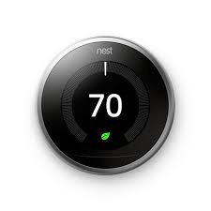
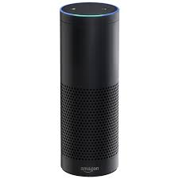
Consider an IoT Application
Set Temperature to 70
Temperature = 70

Slide 40
HTTP: RESTful
A “request” is sent to a server via URL
Eg. http://api.example.com/resources/user/1036721?name=something
Response is usually text in HTML, XML, or JSON
Great if your asking for something
What about “push”
Eg. Server wants to tell device to do something

Slide 41

HTTP: RESTful Hypothetical Light Switch
Cell Phone
Server
api.example.com/turnoff
api.example.com/shoulditurnoff
WiFi Switch
Should I turn off?
No
Process Response
Yes
Turn off

Slide 42
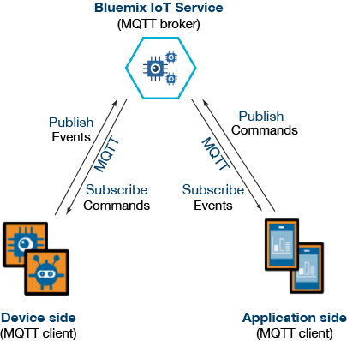
MQTT: Message Queuing Telemetry Transport

Slide 43
MQTT: Pub/Sub
Clients connect to a “Broker”
Clients subscribe to topics eg,
client.subscribe(‘toggleLight/1’)
client.subscribe(‘toggleLight/2’)
client.subscribe(‘toggleLight/3’)
Clients can publish messages to topics:
client.publish(‘toggleLight/1’, ‘toggle’);
client.publish(‘toggleLight/2’, ‘toggle’);
All clients receive all messages published to topics they subscribe to
Messages can be anything
Text
Images
etc

Slide 44
MQTT Hypothetical Light Switch
Cell Phone
Broker
client.publish(‘lightSwitch/1’, ‘toggle’)
‘toggle’
WiFi Switch
Toggle Switch

Slide 45
Backend- cloud Services
Notes:
Module 1 and 2

Slide 46


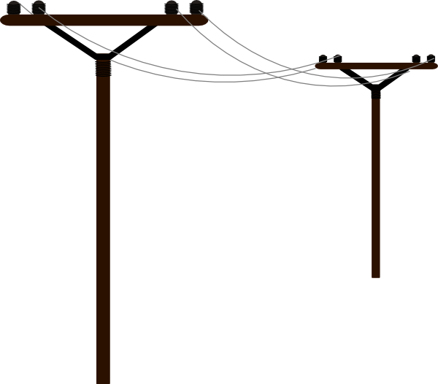





Decision Support Systems/Computing Layer
Human Layer
Handle the velocity and volume of data flows
Establish and implement Security Constraints
Ensure Timing Constraints
Maintain Reliability
Cloud
Resource availability
Smart Application Layer
Decision Support Systems
Fog
Networking Layer
Data source proximity
Physical System and Sensors
Edge (Sensors, Actuators)
The computing layer tradeoff is between latency, reliability and cost

Slide 47
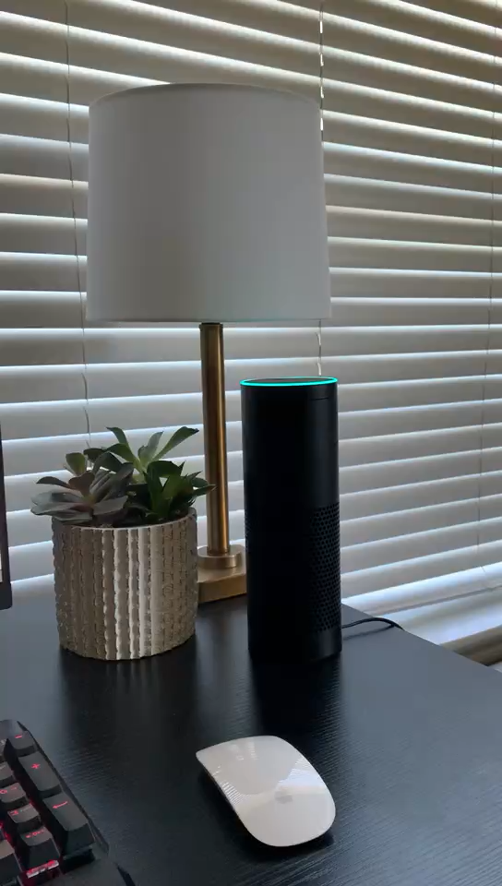
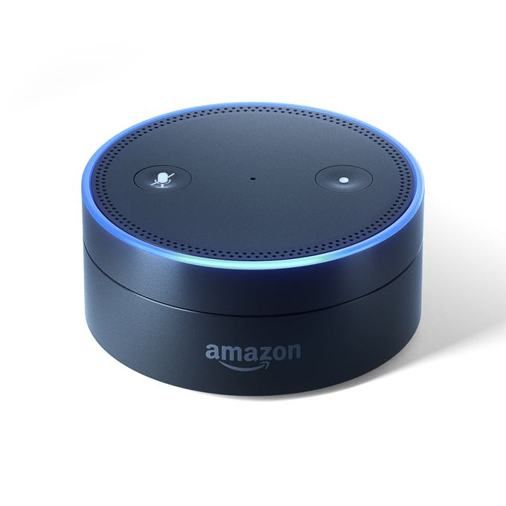






Smart Building – Room Service
Room 101
Ok, let me notify dining room
Order a pizza
Room 101 needs a pizza
Room 101 needs a pizza
We are preparing your foods, thanks for ordering
Pizza is available,
this order has been
confirmed
My receipt
Customer receipt
Light up hue

Slide 48
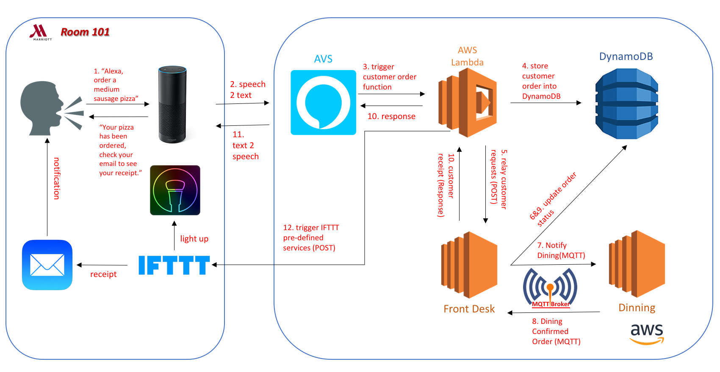
Smart Building – Room Service

Slide 49
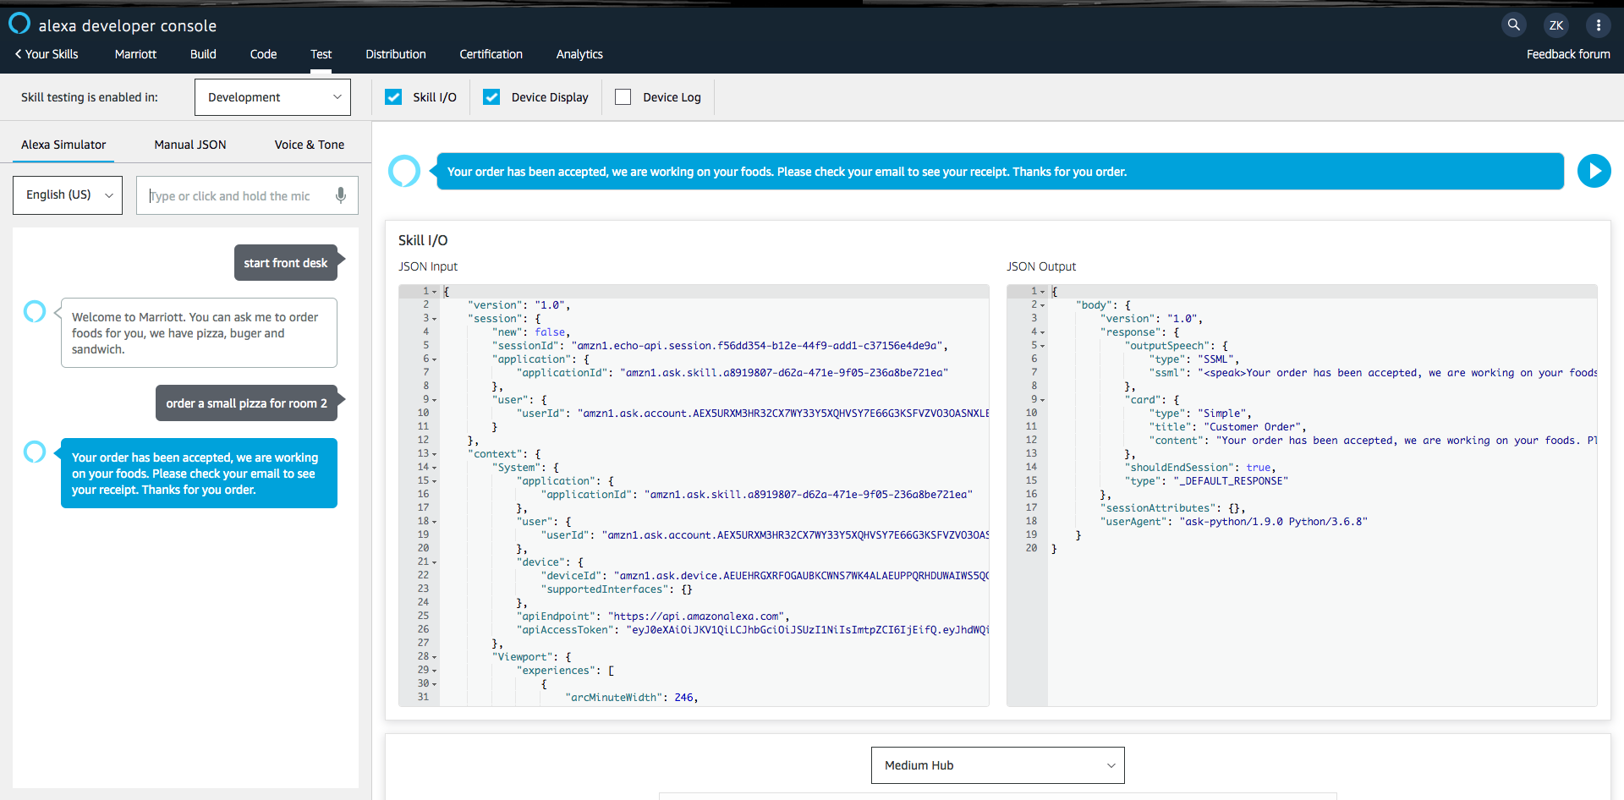
Alexa Voice Service
Convert user’s voice input stream received from Echo to a json object.
Convert Lambda’s json output, which is the response for user’s request, to a voice stream.

Slide 50
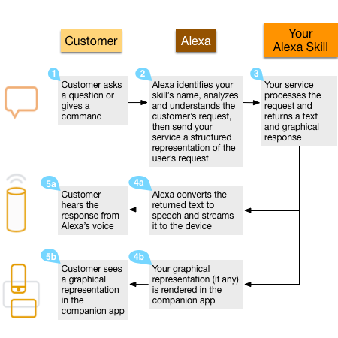
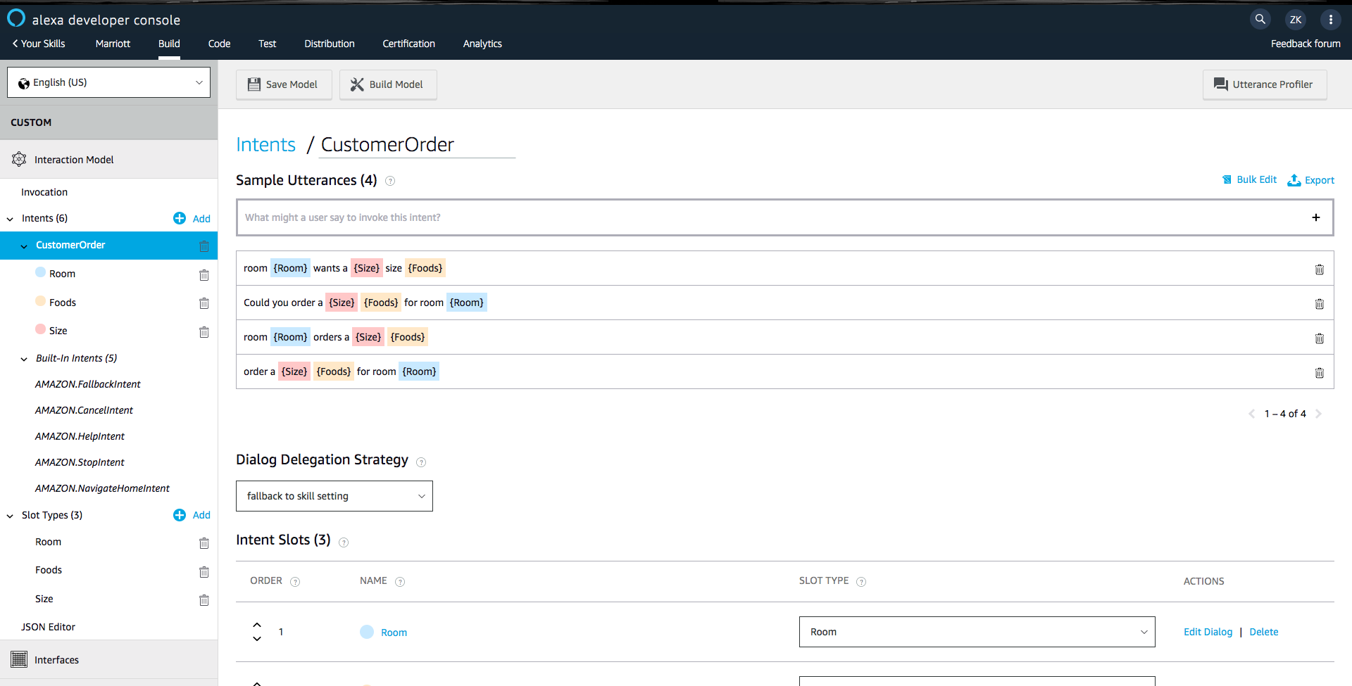
Alexa Custom Skill
Processing Procedures:
Define Alexa Custom Skill:

Slide 51
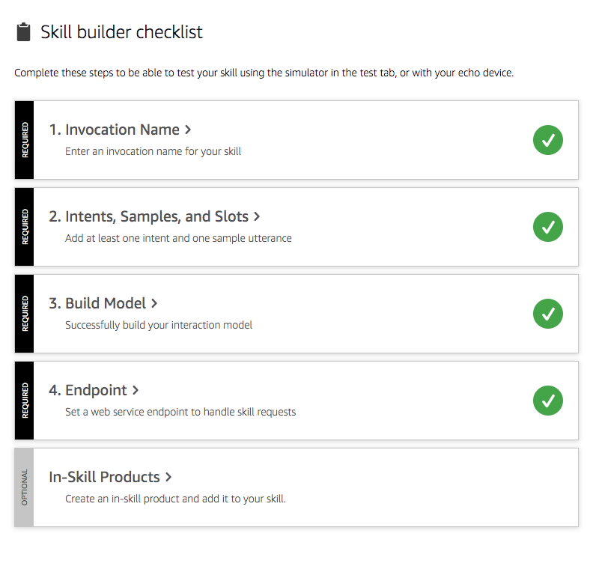
Alexa Custom Skill(2/2)
Key Notions in Alexa Custom Skill
Invocation Name: Few words for invoking your skill, like “Alexa” is the default invocation name.
Intents: similar to an event, such as “clean room”, “order foods”, etc.
Slots: components of an events, for example, in a “order foods” event, user always need to provide “food name”, “room id”, etc, these components are defined as slots in Alexa.
Sample Utterance: a developer defined request format for submitting users’ voice commands. Such as, “Alexa, order a small pizza for room 101”, or you can say “Alexa, room 101 needs a small pizza” Not only request, developers also can define how does Alexa respond them. It’s also sample utterance.
Endpoint: a platform to handle skill requests, such as AWS Lambda.

Slide 52
AWS Lambda
AWS Lambda is an event-driven, serverless computing platform provided by Amazon as a part of the Amazon Web Services. It is a computing service that runs code in response to events and automatically manages the computing resources required by that code.
Two features:
Event-driven: the flow of program is determined by events such as user’s action, in our case, user’s action is their voice input
Serverless computing: it does not need a server. It means servers are managed by cloud provider like AWS, Azure, AliCloud, etc. Developers don’t need to manage the server by themselves and resources are dynamically allocated by cloud provider.
Servers are short-lived and get created on-demand.
AWS uses it to consolidate idle physical resources.

Slide 53
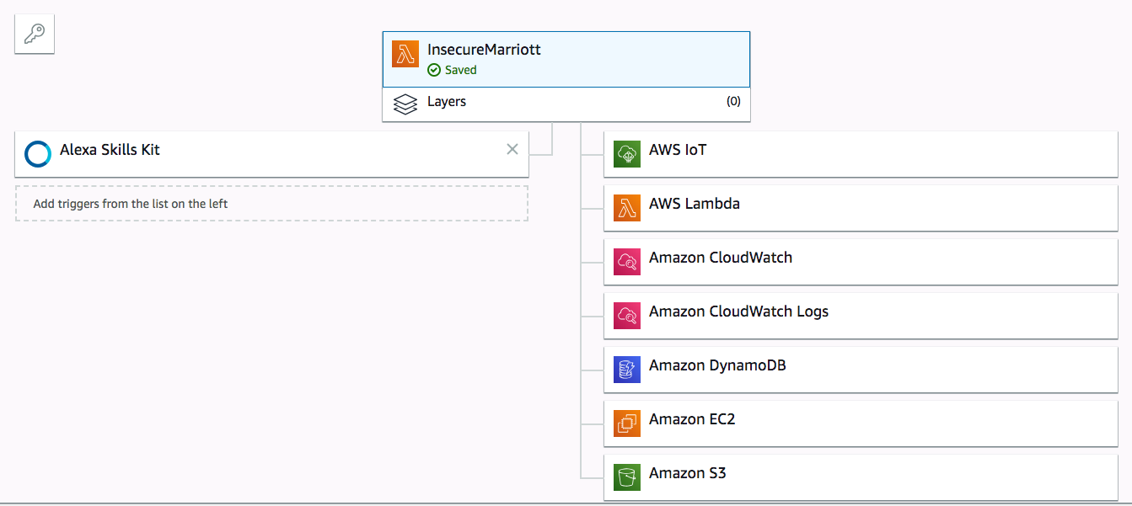
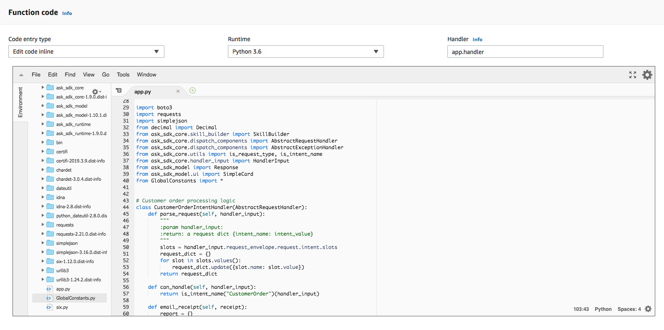
AWS Lambda(2/2)
Schema Design
Function Code

Slide 54
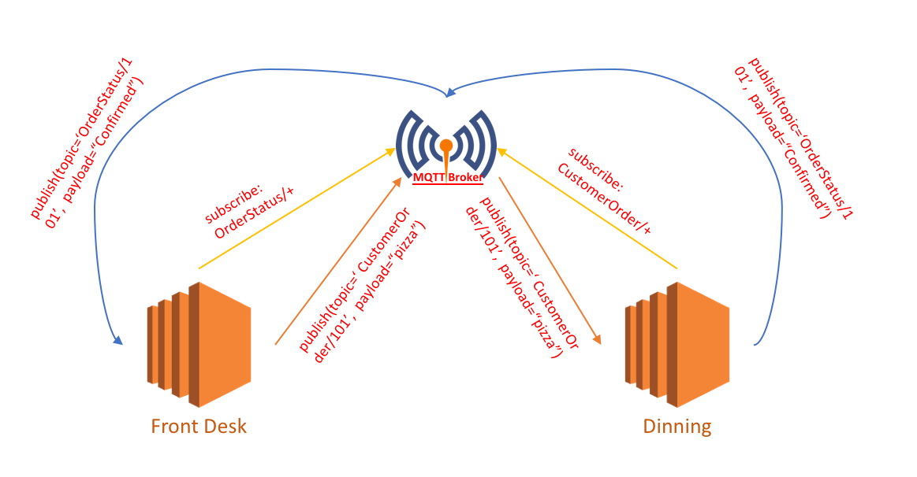
MQTT
MQTT is a lightweight publish/subscribe message transportation protocol that works on top of TCP/IP protocol.
Roles in MQTT system:
MQTT clients: publishers or subscribers
MQTT server(broker): can run on MQTT online server or your own server. There is a Topic Filter in the broker to map messages received from publishers to subscribers.

Slide 55
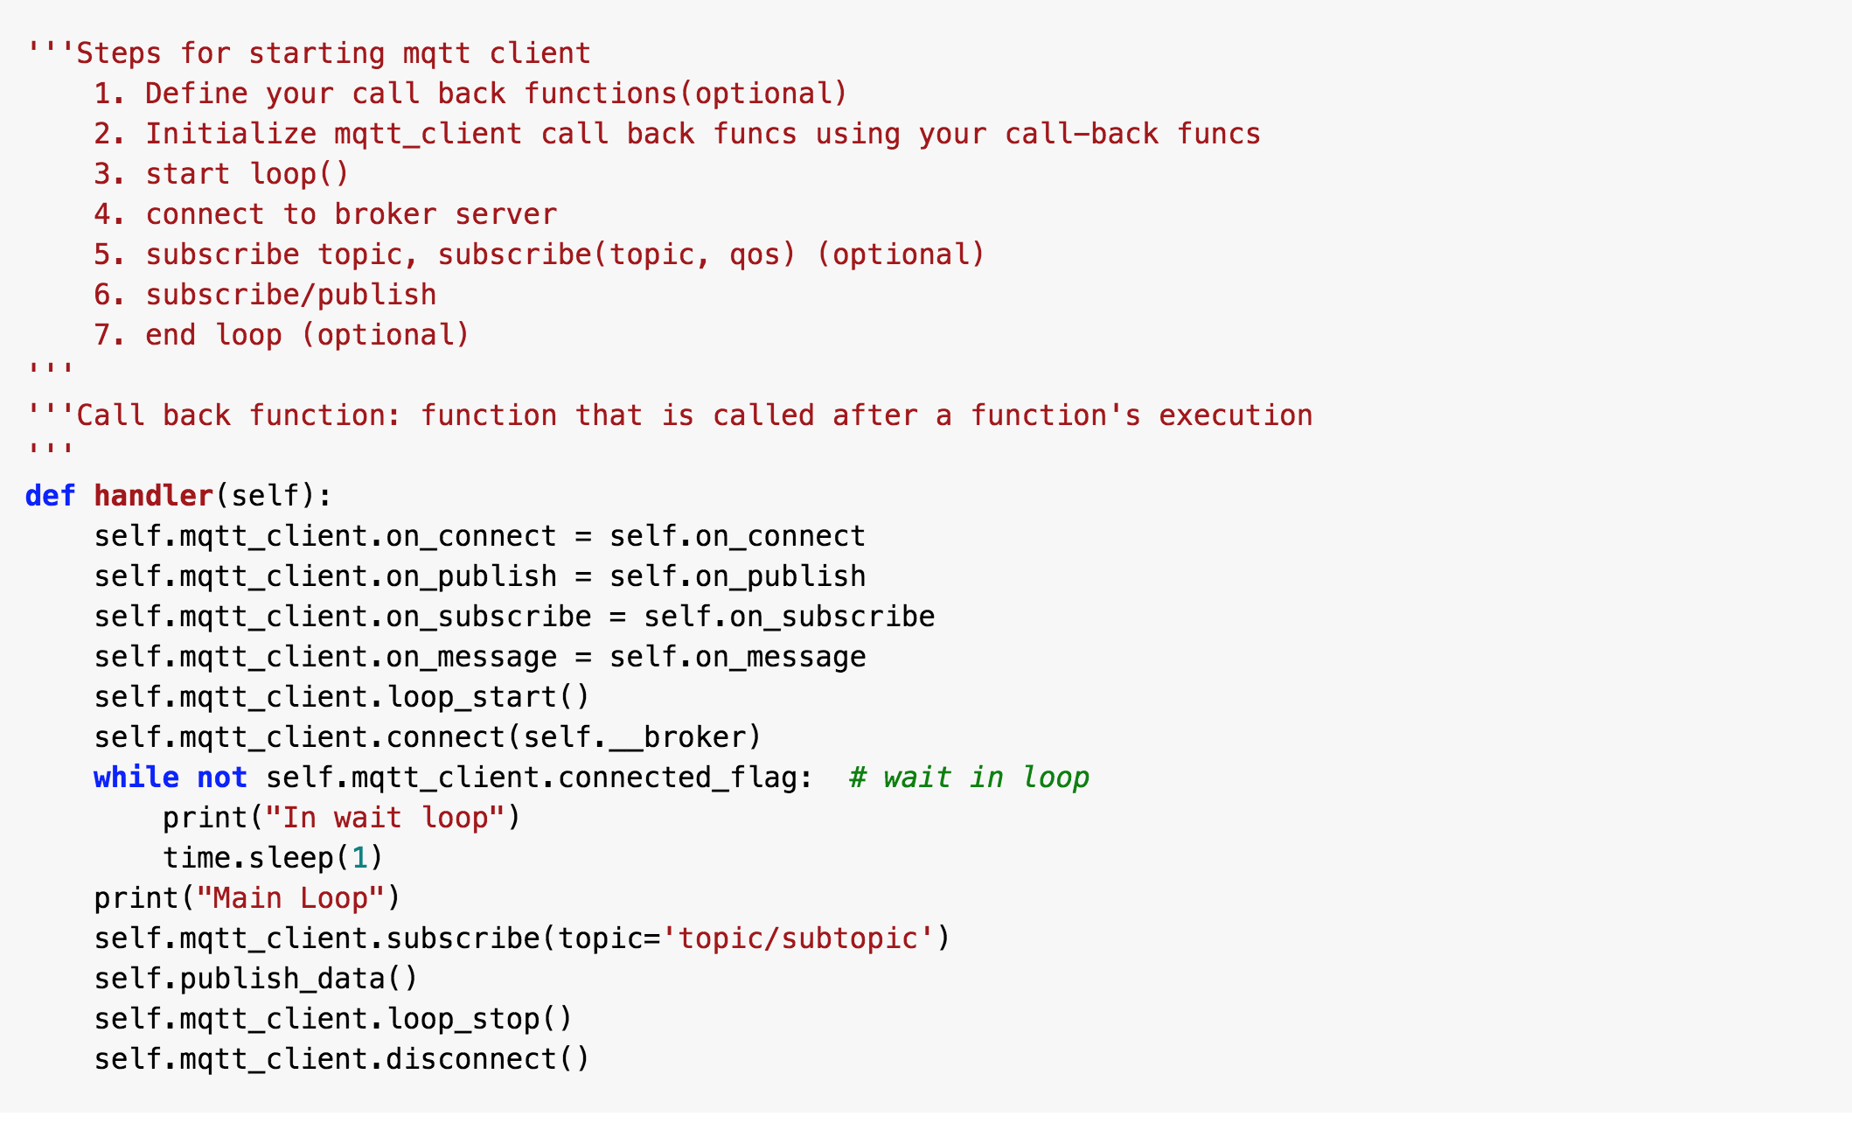
MQTT(2/2)
MQTT Python API:
paho-mqtt
A piece of insecure sample code:

Slide 56
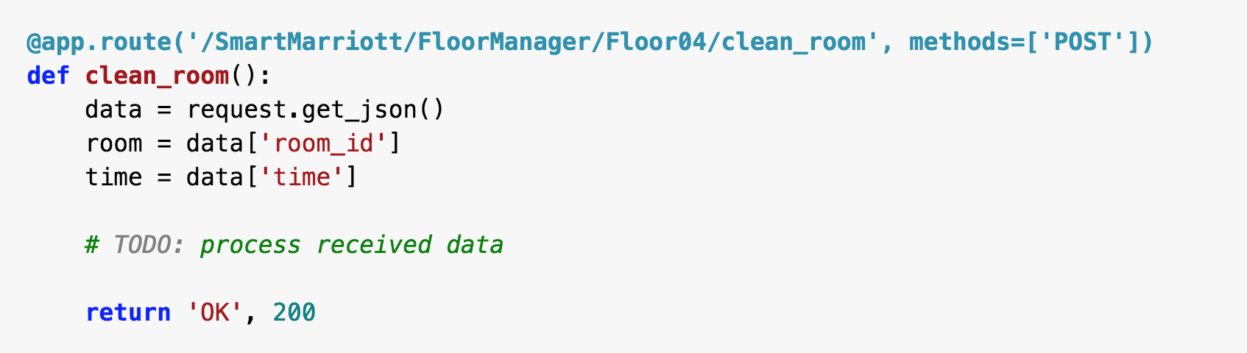
Flask
A popular Python web framework; in other words, it’s a third-party Python library for developing web applications.
Assuming your URL is: http://129.11.22.33:5000/customer_order
And you send a json object to the server using the POST method.
What does flask do?

Slide 57
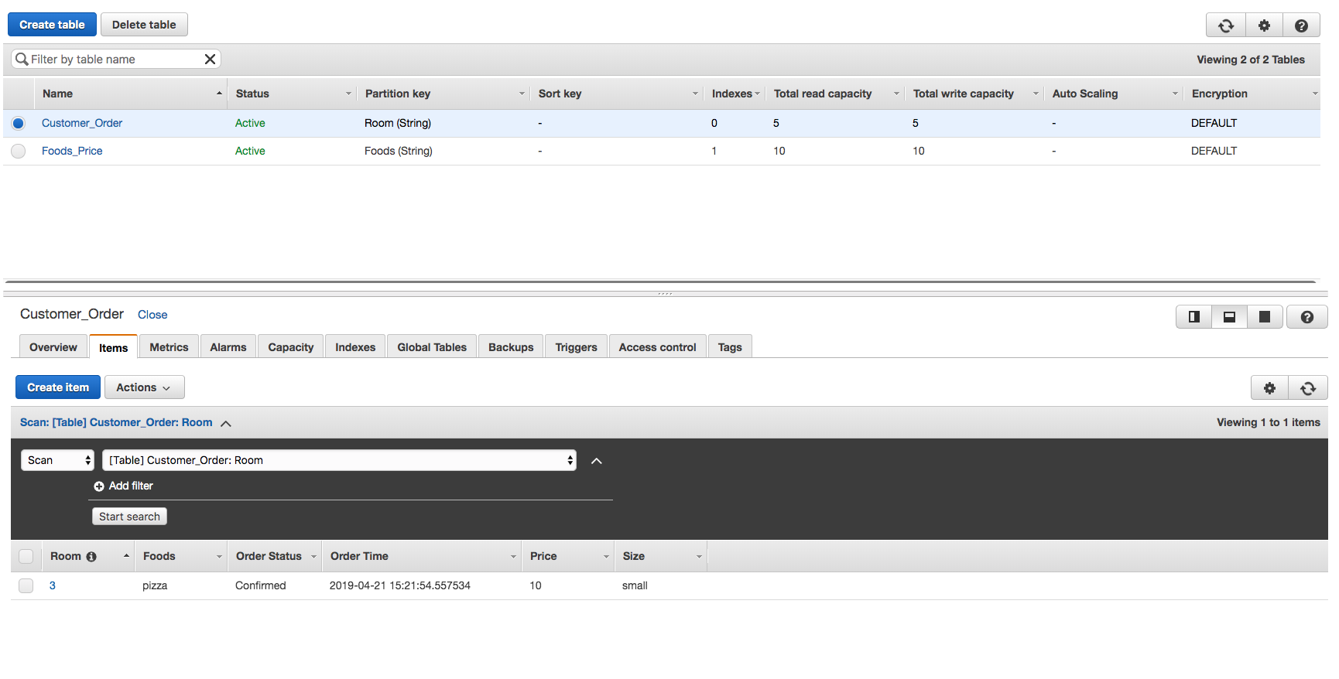
DynamoDB
Amazon DynamoDB is a key-value and document NoSQL database that delivers single-digit millisecond performance at any scale.

